Slide 1
Creating a cultural star
Look at my example on slide 2
Create your own on slide 3!
NO prizes for the best star! Don’t worry about what it looks like – it’s just a conversation starter!

Slide 2
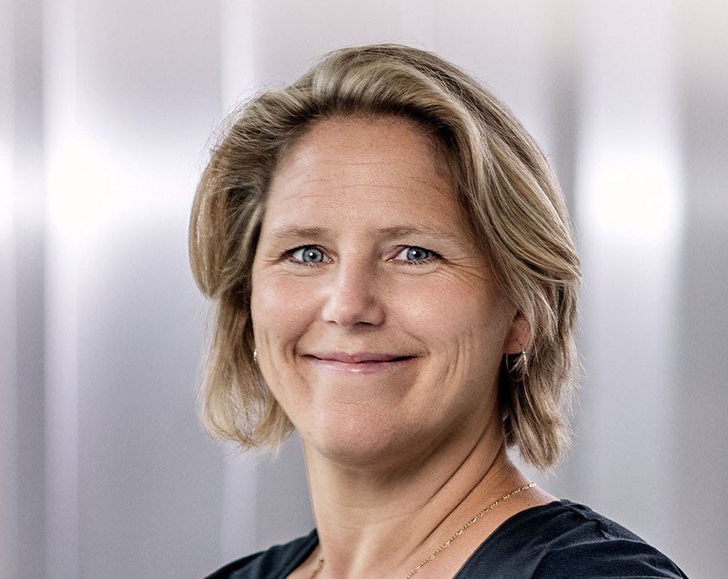
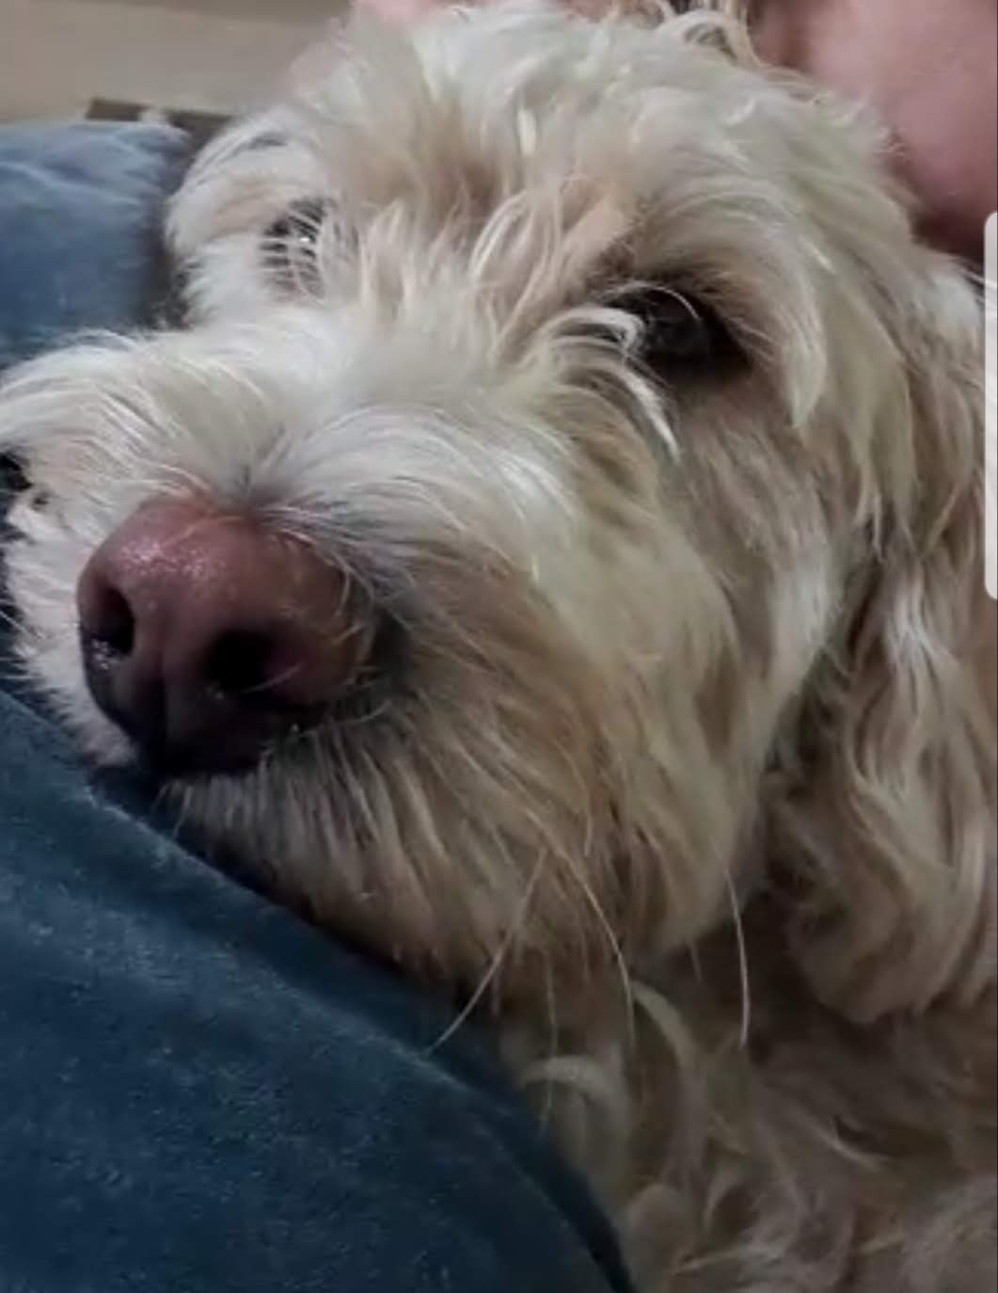
Example Culture star: Becky Bergman
Senior lecturer at Department for Communication and Learning in Science
Researcher in intercultural communication in engineering education
Lived on 5 continents (worked on 4)
Becky
British / Swedish
Holliday et al, 2010
Notes:
Draw own cultural star and share with group.
What does it mean to be a part of those cultures?
15 mins

Slide 3
Culture star: Name
Note:
You can change any of the categories here to something that feels more relevant e.g. hobbies? Interests? Favourite food? Something else? You can even add points to the star!
Previous studies
(we know what you’re doing now but what about past study experiences?)
Work experience?
If you have any..or make up your own category here
Significant family relationships
(I’ve highlighted being a mother in my case but you might pick something else – or a different category completely!)
Becky
Significant travel experience
(by ”significant” in some way i.e. places you ’ve spent some time in or affected you in some way?)
Nationality (ies)
(or languages spoken?)
Holliday et al, 2010
Notes:
Draw own cultural star and share with the person next to you.
What does it mean to be a part of those cultures?
15 mins

